Slide 1
CHAPTER 1
LOGIC AND PROOFS

Slide 2
CONTENTS
1.1 Logic
1.2 Propositional Equivalences
1.3 Predicates and Quantifiers

Slide 3
1.3 Predicates and Quantifiers
1.3.1 Predicates
1.3.2 Quantifiers
1.3.3 Negations
1.3.4 Biding Variables

Slide 4
1.3.1 Predicates
Which statements are propositions:
Minh loves ice cream.
X loves ice cream.
Everyone loves ice cream.
Someone loves ice cream.
YES
NO
YES
YES

Slide 5
1.3.1 Predicates
Which statements are propositions:
3 + 2 = 5
YES
X + 2 = 5
NO
X + 2 = 5 for any choice of X in {1, 2, 3}
YES
X + 2 = 5 for some X in {1, 2, 3}
YES

Slide 6
Proposition, YES or NO?
12 > 4
YES
X > 4
NO
X > 4 for any choice of X in {3, 4, 5}
YES
X > 4 for some X in {1, 2, 3}
YES

Slide 7
Predicates.
Definition: A predicate, or propositional function, is a function defined on a set U and returns a proposition as its value.
The set U is called the universe of discourse.
We often denote a predicate by P(x)
Note that P(x) is not a proposition, but P(a) where a is some fixed element of U is a proposition with well determined truth value

Slide 8
Predicates
Let Q(x,y) = “x > y”
Which statements are propositions:
Q(x,y)
NO
Q(3,4)
YES
Q(x,9)
NO
Q(x,y) is a predicates in two free variables x and y in R

Slide 9
The universal quantifier ∀
Let P(x) be a predicate on some universe of discourse U.
Consider the statement : ∀x P(x)
say “P(x) is true for all x in the universe of discourse.”
“for all x, P(x) ”
The proposition ∀x P(x) is called the universal quantification of the predicate P(x).
∀x P(x) is TRUE if P(a) is true when we substitute x by any element a in U
∀x P(x) is FALSE if there is an element a in U for which P(a) is false.

Slide 10
Examples:
Let P(x) be the predicate x + 1 > x, where the universe of discourse are the real numbers.
Is ∀x P(x) a TRUE proposition ?
Let Q(x) be the predicate x < 1, where the universe of discourse are the real numbers.
Is ∀x Q(x) a TRUE proposition ?

Slide 11
In the special case that the universe of discourse, U, is finite, say U = {x₁, x₂, x₃, …, x_{n}}. Then
∀x P(x)
corresponds to the proposition:
P(x₁) ∧ P(x₂) ∧ … ∧ P(x_{n})

Slide 12
The existential quantifier ∃
Let P(x) is a predicate on some universe of discourse.
The existential quantification of P(x) is the proposition:
∃x P(x)
say “for some x, P(x)”
“There exists an element x in the universe of discourse such that P(x) is true.”
∃ is called the existential quantifier
∃x P(x) is FALSE if P(x) is false for every single x.
∃x P(x) is TRUE if there is an x for which P(x) is true.
Notes:
another way of changing a predicate into a proposition.

Slide 13
Examples:
Let P(x) be the predicate x > 3, where the universe of discourse are the real numbers.
Is ∃ x P(x) a TRUE proposition ?
Let Q(x) be the predicate x = x + 1, where the universe of discourse are the real numbers.
Is ∃ x Q(x) a TRUE proposition ?

Slide 14
In the special case that the universe of discourse, U, is finite, say U = {x₁, x₂, x₃, …, x_{n}}. Then
∃x P(x)
corresponds to the proposition:
P(x₁) ∨ P(x₂) ∨ … ∨ P(x_{n})
Notes:
We can write a program to loop through the elements in the universe and check each for truthfulness.
The program will stop when we find an element x_{i} such that P(x_{i}) is true. In this case the Proposition is true.
Otherwise, it is false

Slide 15
Precedence of Quantifiers
The quantifiers ∀ and ∃ have higher precedence than all logical operators from propositional calculus.
Example: ∀xP (x) ∨ Q(x) is the disjunction of ∀xP (x) and Q(x).

Slide 16
Negating quantifier propositions
¬ ∀x P(x) ≡ ∃x ¬P(x).
¬ ∃x P(x) ≡ ∀x ¬P(x).
General rule: to negate a quantification,
move negation (¬) to the right,
change the quantifier from ∀ to ∃, and from ∃ to ∀.

Slide 17
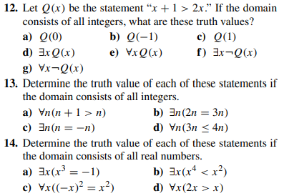

Slide 18
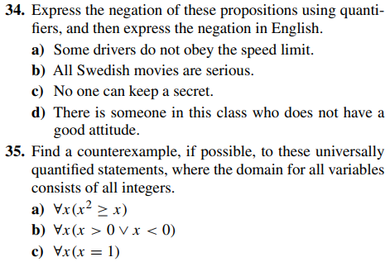

Slide 19
Predicates - multiple quantifiers
Example: P(x,y) = “x > y”
∀x P(x,y)
NOT a proposition
∀x∀y P(x,y)
FALSE proposition
∀x∃y P(x,y)
TRUE proposition
∀x P(x, 3)
FALSE proposition

Slide 20
Predicates - the meaning of multiple quantifiers
“∀x∀y P(x,y)” means P(x,y) is true for every possible combination of x and y.
“∃x∃y P(x,y)” means P(x,y) is true for some choice of x and y (together).
“∀x∃y P(x,y)” means for every x we can find a (possibly different) y so that P(x,y) is true.
“∃x∀y P(x,y)” means there is (at least one) particular x for which P(x,y) is always true.
Notice: quantifier order is not interchangeable!

Slide 21
Predicates - the meaning of multiple quantifiers
Example: N(x,y) = “x is sitting next to y”
∀x∀y N(x,y) - everyone is sitting next to everyone else.
False
∃x∃y N(x,y) - there are two people sitting next to each other.
True?
∀x∃y N(x,y) - every person is sitting next to somebody.
True?
∃x∀y N(x,y) - a particular person is sitting next to everyone else.
False

Slide 22
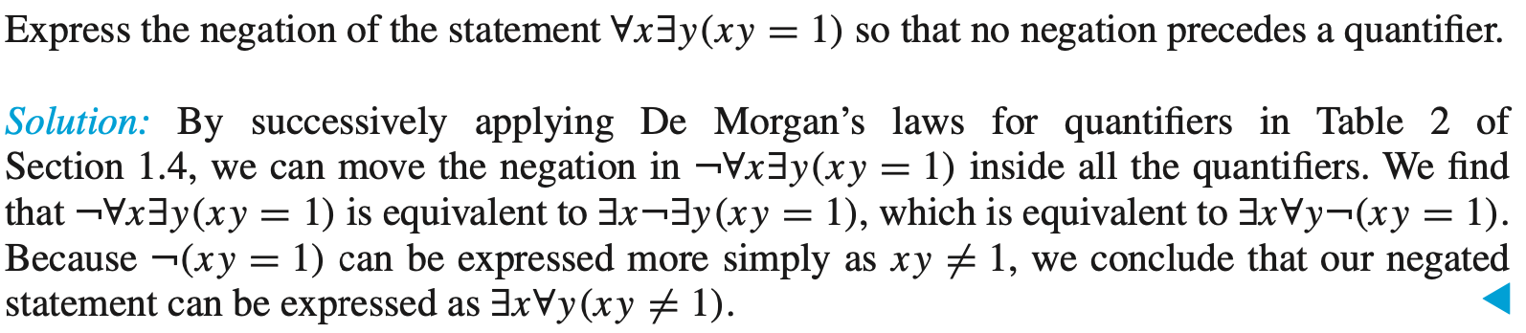
Example:

Slide 23
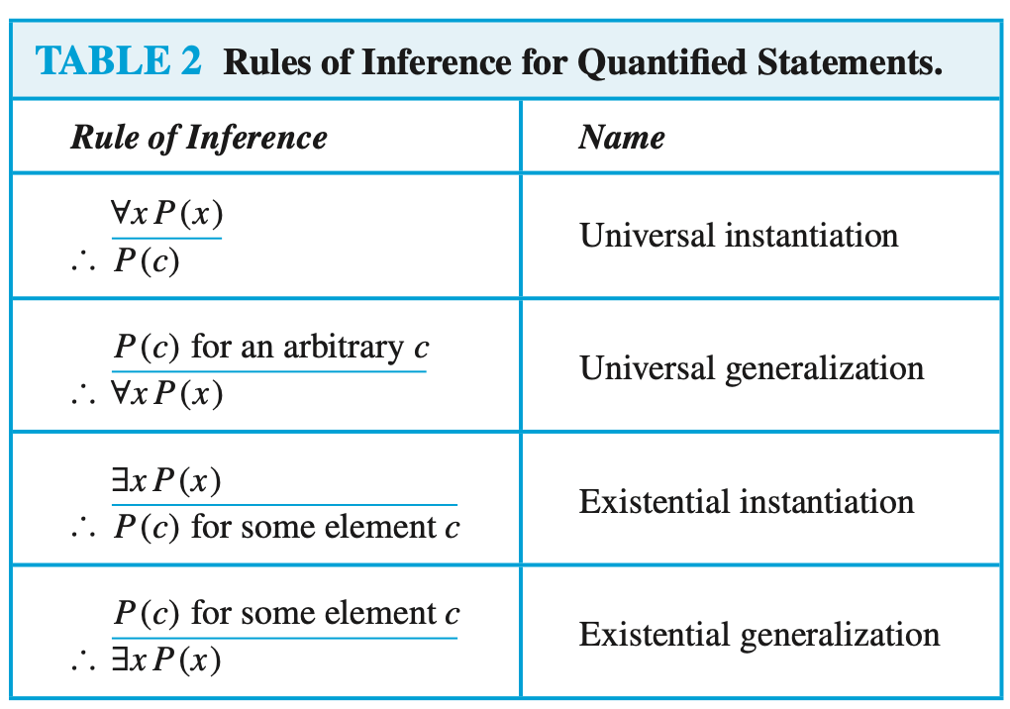

Slide 24
Show that the premises “A student in this class has not read the book,” and “Everyone in this class passed the first exam” imply the conclusion “Someone who passed the first exam has not read the book.”

Slide 25
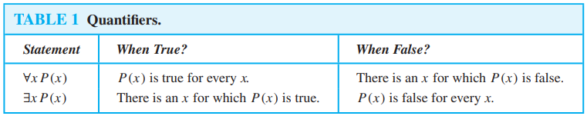
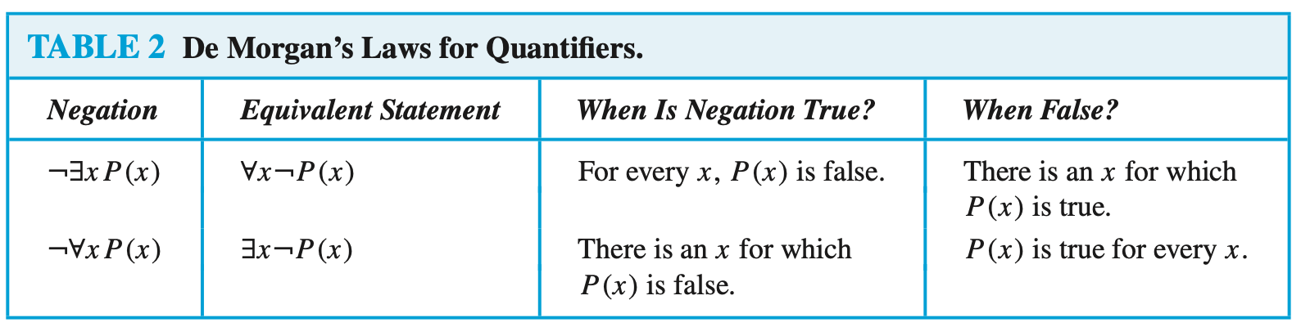
Summary

Slide 26
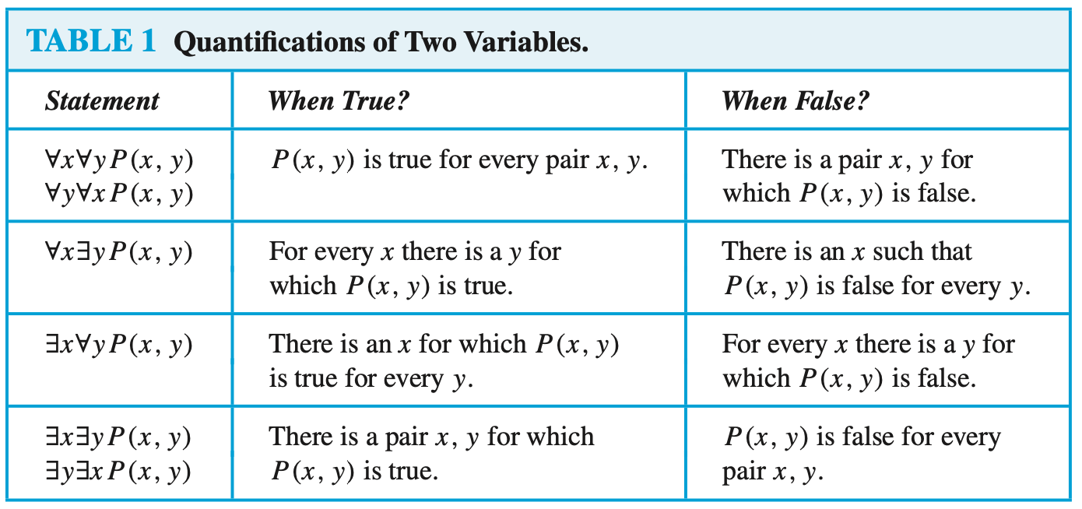

Slide 28
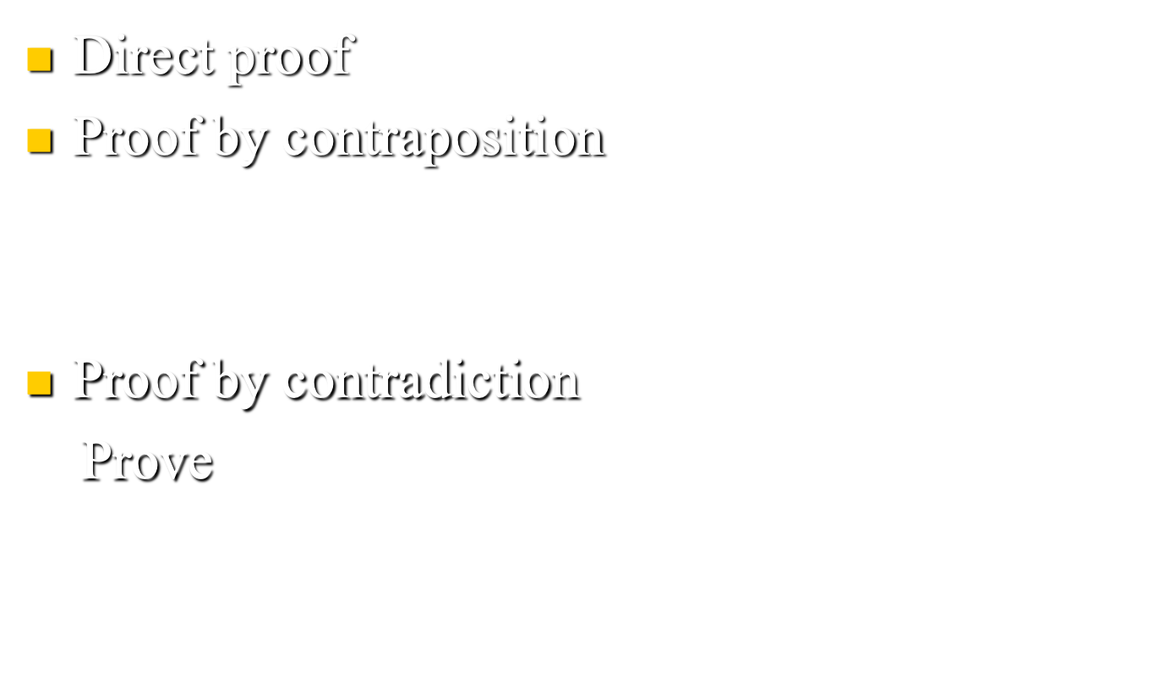
Method of proving

Slide 29
